Slide 1
HAND WRITING RECOGNIZER
Submitted to:
G.Sandhya Rani,
Assistant prof,
Dept. Of CSE,
CBIT
Submitted by:
Ramya.B
1601-12-733-071,
CSE-2,3/4,
CBIT

Slide 2
ABSTRACT
OCR serves as the foundation for the handwriting recognition technology.
This Handwriting Recognition Project proposes to recognize a wide variety of supervised characters like alphabets, numbers, numerals, etc from a set of diverse handwritings sample
The software identifies the respective characters and displays the characters read

Slide 3
PROGRAMMING LANGUAGE
java

Slide 4
DATA FLOW DIAGRAMS
LEVEL 0 :
Handwriting
Recognizer
INPUT
OUTPUT
User
User

Slide 5
LEVEL 1:
Handwrit-ten Image
Compare algorithm
Collection of Handwriting samples
INPUT
USER
Verification
YES
NO
Display of text in the image (text recognition)
Match not found

Slide 6
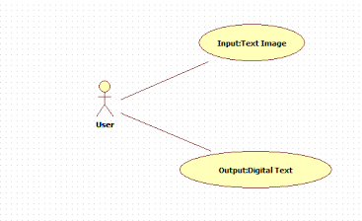
USE CASE DIAGRAM:

Slide 7
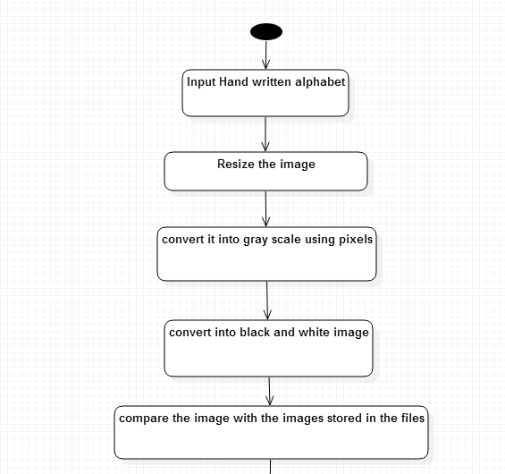
ACTIVITY DIAGRAM

Slide 8
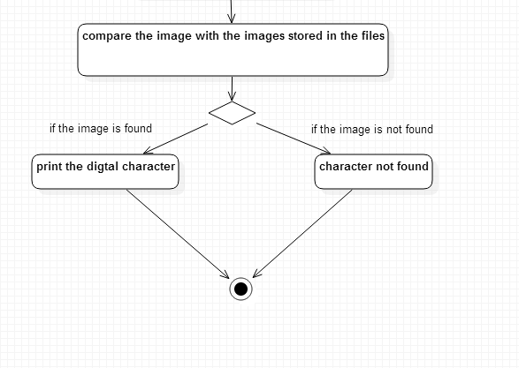

Slide 9
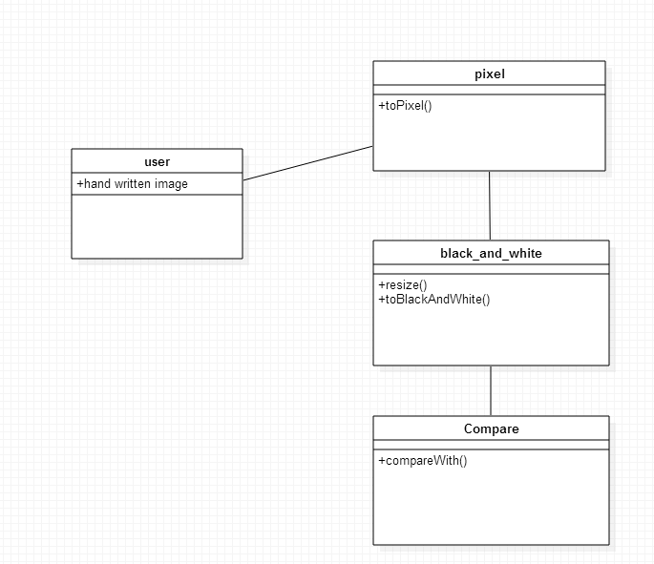
CLASS DIAGRAM:

Slide 10
PIXEL
Short for Picture Element, a pixel is a single point in a graphic image. Graphics monitors display pictures by dividing the display screen into thousands (or millions) of pixels, arranged in rows and columns. The pixels are so close together that they appear connected.

Slide 11
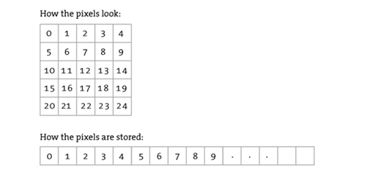

Slide 12
BUFFERED IMAGE
The BufferedImage subclass describes an Image with an accessible buffer of image data.
A BufferedImage is comprised of a ColorModel and a Raster of image data.

Slide 13
References
http://www.tutorialspoint.com/java_dip/understand_image_pixels.htm
http://processing.org/tutorials/pixels/
http://web.teipir.gr/JAVA/api/java.awt.image.PixelGrabber.html

Slide 14


Slide 15


